Slide 1

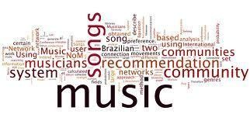

Prem Jadwani
Kavish Mudai
Krishna Khanduja
Jappan Sharma

Slide 2

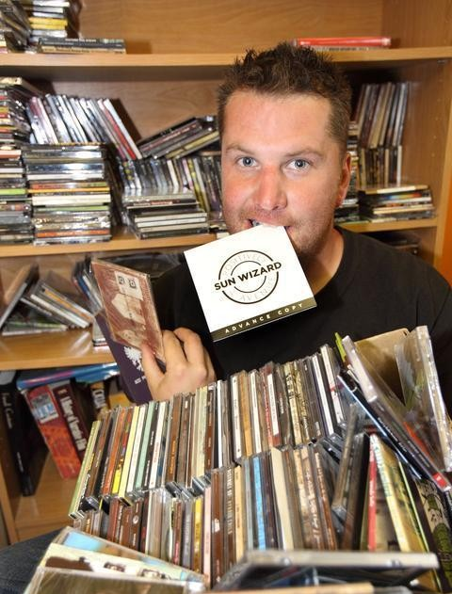

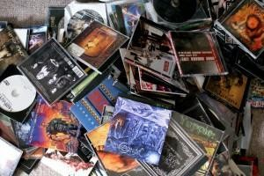


Slide 3

Music dataset is too big while life is short!!!! You need someone to teach you how to manage and give you wise suggestions according to your taste!
Music service providers need a more efficient system to attraction their clients!

Slide 4

Music Recommender System
User‘s listening history &music information
Prediction of songs that user will listen to
Our system: off-line system

Slide 5

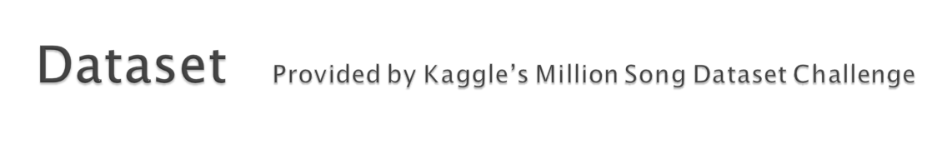
Features:
Large-scale: 1 000 000 users
15000 000 songs
Open
Implicit feedback
Content:
Triplets (user, song, count)
Meta-data, content-analysis
No users’ demographic information,
timestamp
Too big dataset:
Difficult to implement the whole dataset, so need to create a small dataset by ourselves
Format of the Dataset:
Hdf5 files
Need to be opened by a Python Wrapper
Features & Content
Difficulties linked to the Data

Slide 6


1.Popularity based model
2.Same artist greatest hits
Content based
Model
MINII BATCH K MEANS
Nearest Neighborhood
BIRCH
3.Collaborative filtering
4.Content- based Model
SVD

Slide 7

Idea
Pros:
Idea is simple
Easy to implement
Served as baseline
Cons:
Not personalized (users and songs’ information is not taken into account)
Some songs will never be listend
Sort songs by popularity in a decreasing order
For each user, recommend the songs in order of popularity, except those already in the user’s profile
Idea & Steps
Pros & Cons

Slide 8
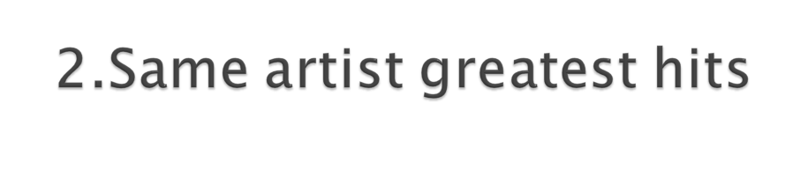
Idea
Pros:
Idea is simple
Easy to implement
Minimum personalized
Sort songs by popularity in a decreasing order
For each user, the ranking of songs is re-ordered to place songs by artists
recommend the songs in the new order, except those already in the user’s profile
Cons:
Only single-meta-data is used
Maximally conservative: doesn’t
explore the space byond songs with which the user is likely already familiar
Idea & Steps
Pros & Cons

Slide 9
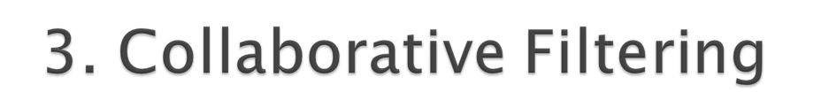
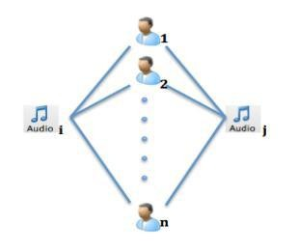
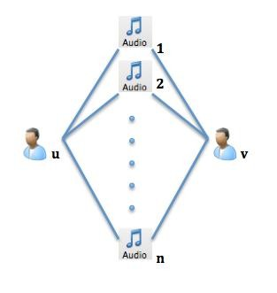
Idea: songs that are often listened by the same user tend to be similar and are more likely to be listened together in future by some other user.
Idea: users who listen to the same songs in the past tend to have similar interests and will probably listen to the same songs in future.
Item-based
User-based

Slide 10
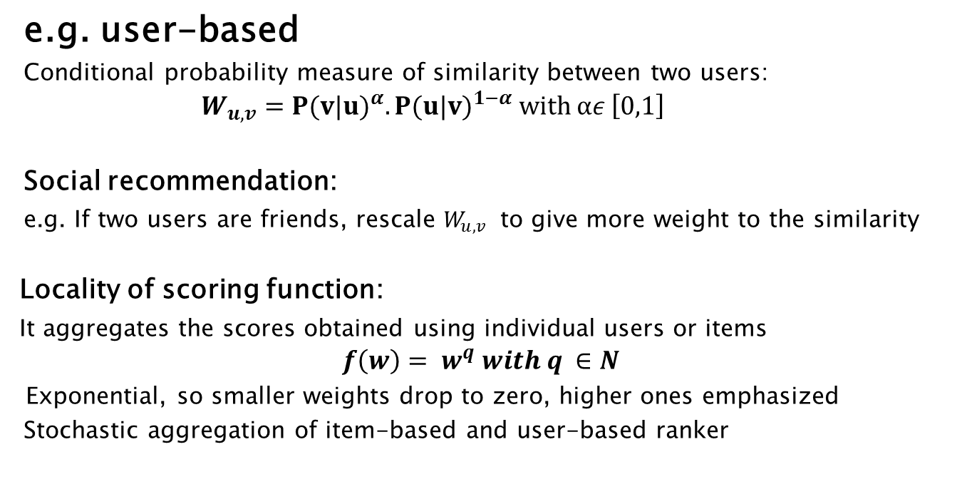
🞂

Slide 11

Based on item’s description and user’s preference profile
Not based on choices of other users with similar interests
We make recommendations by looking for music whose features are very similar to the tastes of the user
Similarity != recommendation (no notion of personalization)
Majority of songs have too few listeners, so difficult to “collaborate”
What’s content-based model?
And Why?

Slide 12
1. Create a space of songs according to songs features. We find out neighborhood of each song.
2. We look at each user’s profile and suggest songs which are
neighbors to the songs that he listens to

Slide 13

Idea: SVD
Listening histories are influenced by a set of factors specific to the domain (e.g. Genre, artist).
These factors are in general not obvious and we need to infer those so called latent factors from the data.
Users and songs are characterized by latent factors.
Personalized
Meta-data is fully used, all the information is well explored
It works well in many tested cases
Idea

Slide 14

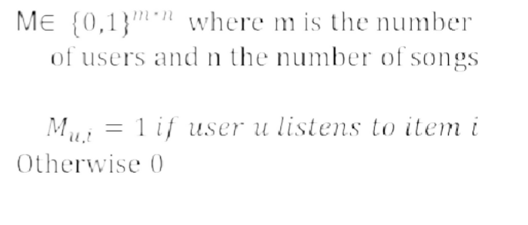
Matrix M, a user-song play count matrix
1 | 0 | 1 | 1 | 0 | 0 | ...
1 | 1 | 0 | 0 | 0 | 0
0 | 1
...

Slide 15
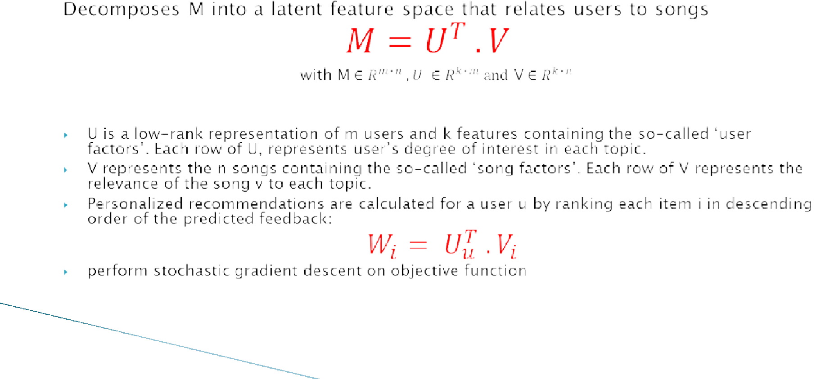
🞂

Slide 16

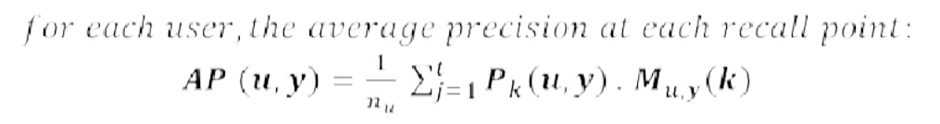
Off-line evaluation
Truncated mAP (mean Average Precision)

Slide 17
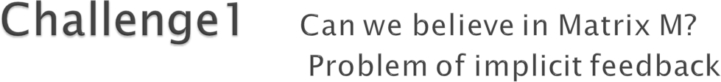
1 | 0 | 1 | 1 | 0 | 0 | ...
1 | 1 | 0 | 0 | 0 | 0
0 | 1
...
Haven’t listend to a song != dislike it. The « 0 » gives a lot confusion and little confidence.
We use weighted matrix factorization
Each entry is weighted by a confidence function so as to put more confidence on non- zero entries

Slide 18
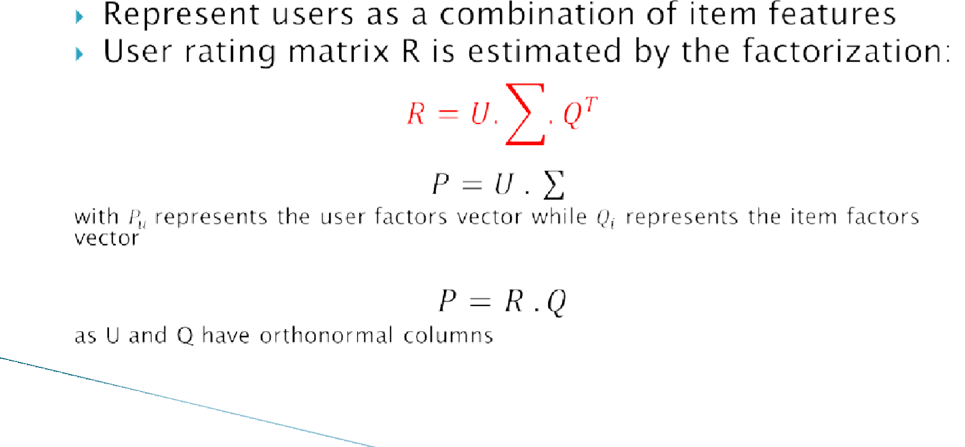
🞂

Slide 19
First latent factors capture properties of the most popular items, while the additional latent factors represent more refined features related to unpopular items.
Number of latent factors influences the quality of
long-tail items differently than head items.

Slide 20
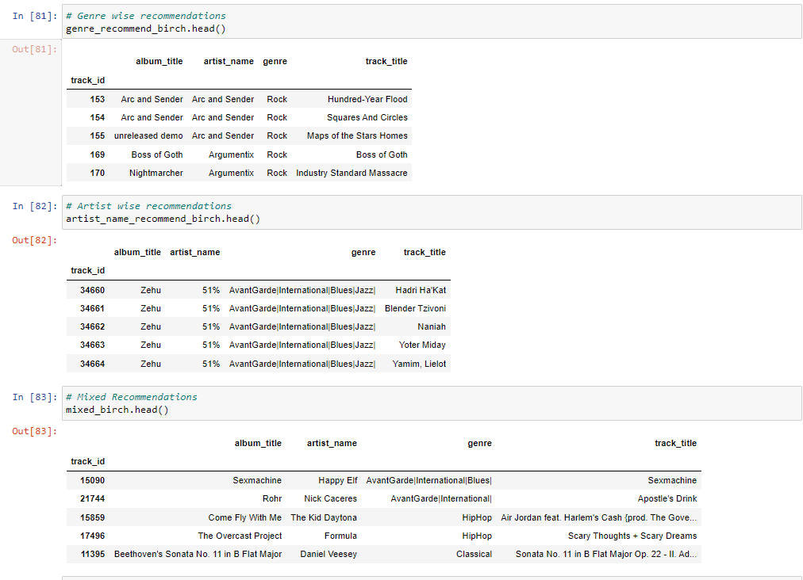
RESULTS

Slide 21



Any questions or
suggestions?

